Slide 1
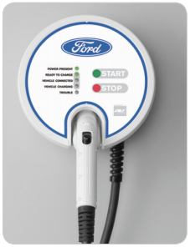

ford CHARGING Station System Validation
EDU Project
karacankos@gmail.com
https://www.linkedin.com/in/omer-karacan/
https://www.instagram.com/karacanos/

Slide 2
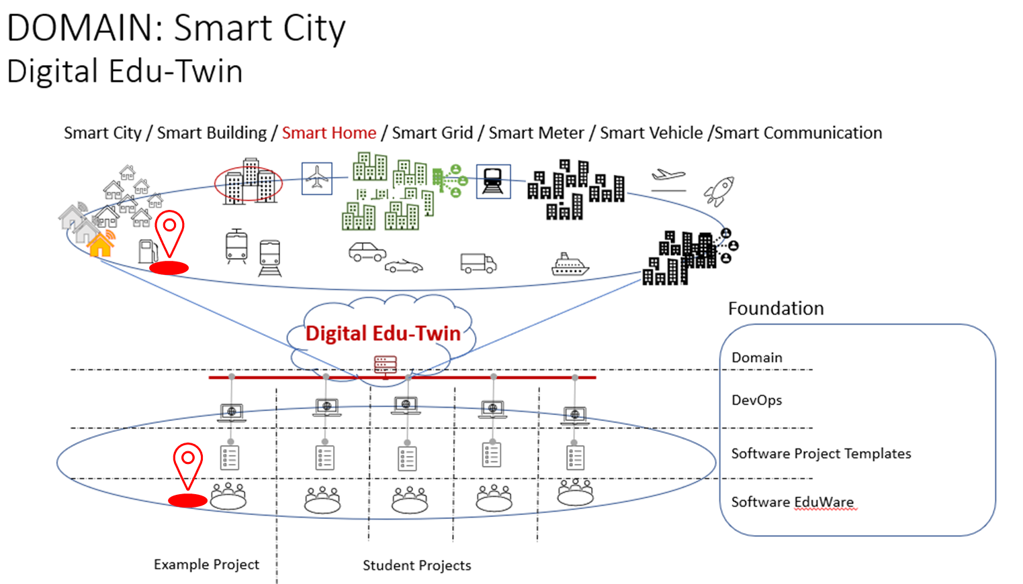

Project Context

Slide 3
System validation (System testing) process Testing Activities (Ref.: ISTQB)
Test planning
Test monitoring and control
Test analysis
Test design
Test implementation
Test execution
Test completion
<insert the picture from SU SW-T>

Slide 4
Test Planning Determining the scope, objectives, and risks of testing Defining the overall approach of testing Making decisions about what to test, the people and other resources Which test activities will be carried out
Best practice: create a list of out-of-scope test cases!
<What is a test risk?>
The System Validation is a testing process to ensure that the system use cases and system requirements are realized correctly. → Objectives
The system functionality, as defined through the system use cases and implemented as webservices are to be tested only in good case scenarios. Testing the defined and generated swagger webservice descriptions are to tested manually (comparison of swagger documentation via walkthrough review). No automation, configuration of test data is expected, i.e., test data may be hard-coded! Secure connection (https) is out-of-scope, since the Validation focuses on the functionality defined by Use Cases (functional requirements)!
Black-box test tool is Postman, where the test cases should be executed when they are triggered by the Tester. The FORDCS YAML-based API description should be imported into a Postman test case Collection! The validation should have a generated evidence (report), which can be generated manually in Postman. Test execution over Postman CLI is out-of-scope! ISTQB test techniques should be utilized where appropriate (mandatory: State Testing and Use Case Testing)→ Scope, What to test?
The validation test cases are derived from the system use cases!
Test case names should follow the conventions according to [UnitOfWork_StateUnderTest_ExpectedBehavior] template,
see https://osherove.com/blog/2005/4/3/naming-standards-for-unit-tests.html
One or more test cases may validate one system use case, which should be clearly traceable, e.g., via test case templates, test case naming conventions, etc.!
For validation testing a document template should be used!
draft EDUp FORDCS-TEST-SPECIFICATION-template-v2022.2.doc
The validation should be 100% automated except test execution start, which is triggered by the Tester!
No test risks are identified???
Notes:
Test planning
Determining the scope, objectives, and risks of testing
Defining the overall approach of testing
Integrating and coordinating the test activities into the software lifecycle activities
Making decisions about what to test, the people and other resources required to perform the various test activities, and how test activities will be carried out
Scheduling of test analysis, design, implementation, execution, and evaluation activities, either on particular dates (e.g., in sequential development) or in the context of each iteration (e.g., in iterative development)
Selecting metrics for test monitoring and control
Budgeting for the test activities
Determining the level of detail and structure for test documentation (e.g., by providing templates or example documents)

Slide 5
Test Planning Which test activities will be carried out

Slide 6
Test monitoring and control

Slide 7
Test analysis

Slide 8
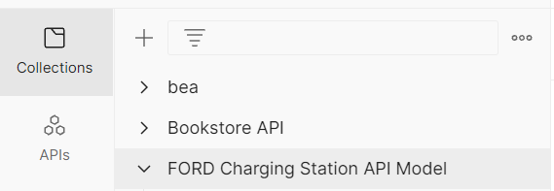
Test design
FORDCS API is to import into a Postman test case Collection
Test Case TC_<use-case-name-test-spec>_<#> → check naming conventions
Test Case TC_<name>_<#>

Slide 9
Test implementation

Slide 10
Test execution

Slide 11
Test completion

Slide 12
BACKYARD
Wichtige Informationen

Slide 13
Car charging state State/Event Table test cases
REVISIT
Test Case | TC #1 | TC #2 | TC #3 | TC #4
Start state | Ready to charge | Vehicle connected | vehicle charging | Vehicle connected
Event/Input | Vehicle_connected | Start_charging | Stop_charging | Vehicle_disconnected
Expected Output | «Vehicle connected» | «vehicle charging» | «Vehicle connected» | «Vehicle disconnected»
End state | Vehicle connected | vehicle charging | Vehicle connected | Ready to charge

Slide 14
Notes
FORD – Charging Station
https://www.evsolutions.com/Upload/Product/635652466512570000.pdf

